Slide 1
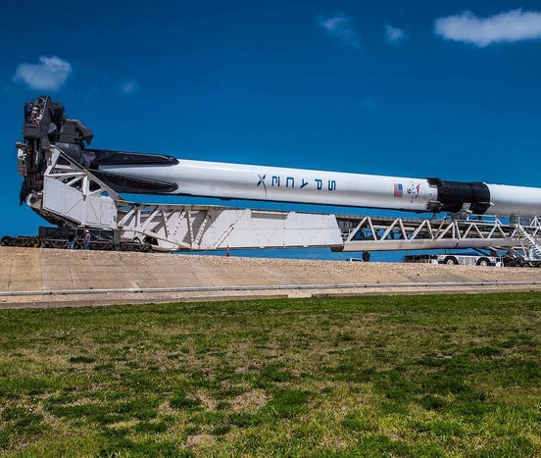
Topic 5: Vibrations in rockets (engine and structure) FINAL EXAM
Justin Millsap
ARO 4060 – Vibrations & Dynamics of Aero Systems
Spring 2024
Dr. Reza Karimi
05/12/2024

Slide 2

The Impact of Vibrations on Rocketry
Vibrations are a critical concern due to their potential to cause structural fatigue
Types of Vibrations:
Acoustic
Mechanical
Aerodynamic
Pogo Oscillations
The Saturn V rocket took Acoustic vibrations into consideration and utilized acoustic dampers to minimize intense noise & vibrations associated with launch.
Pogo Effect: The pogo effect is a longitudinal vibration that occurs when rocket engines oscillate in the thrust direction which can potentially impact the structural integrity.
The Apollo 6 mission experienced severe pogo oscillations.

Slide 3
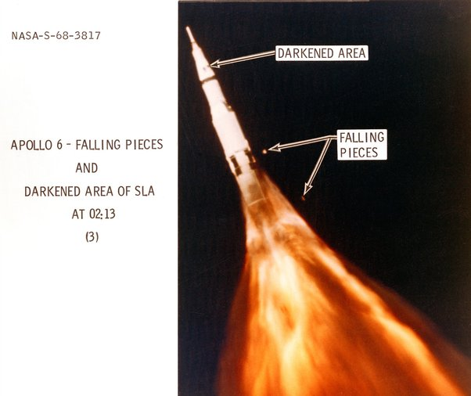
Historical Challenges with Rocket Vibrations
Gemini Program & The Titan II:
The Titan II was used in the Gemini Program and NASA noticed the pogo effect in this specific mission leading to possible impacts on safety and mission objectives.
Gemini 5 was the first manned mission to experience pogo oscillations. The vibrations were between 10-13 Hz which is equivalent to +/- 2.5 G’s.
The Apollo 6 Incident:
The Apollo 6 mission encountered pogo oscillations resulting in structural damage
Resulted in dislodging of panels and threatening the lunar module adapter which lead to advanced damping systems.

Slide 4
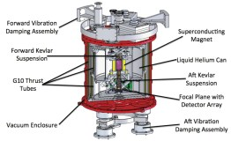
Vibration Mitigation Strategies in Rocketry
Integrating Damping Systems:
The implementation of damping systems was crucial in reducing the resonance effects that contribute to pogo.
For the Saturn V rocket, NASA engineers installed helium-filled accumulators as dampers in the liquid oxygen lines to absorb the energy from pogo oscillations, reducing their amplitude and protecting the structural integrity of the rocket.
Redesign of Fuel System:
Alterations to rocket fuel systems have been made to prevent vibrations from starting.
Following the pogo events, redesigns included changes to the propellant feed system to modify the natural frequencies of the components, such as adjusting pipe lengths and adding baffles to disrupt the oscillation cycle​.
Structural Reinforcement:
Strengthening the physical structure of rockets has been a direct approach to mitigating the effects of both pogo and other forms of vibration.
The Titan II rockets underwent structural reinforcement, with increased pressure in the fuel tanks to reduce pogo amplitude, indicating the direct relationship between structural design and vibration control.
Notes:
The implementation of damping systems was crucial in reducing the resonance effects that contribute to pogo.

Slide 5
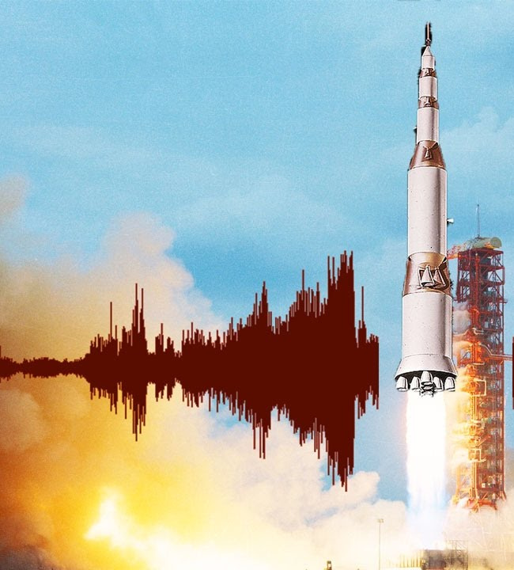
The Path Forward in Rocket Vibration Control
Embracing New Materials:
Research into new composite materials aims to create rocket structures that inherently dampen vibrations.
Investigating materials like meta-materials that can have their vibrational properties tailored to specific frequencies, potentially allowing for a passive control of vibrations.
Advanced Computational Modeling:
Advancements in computational fluid dynamics and structural modeling allow for more precise prediction and mitigation of vibrational issues before physical testing.
Utilization of large-scale simulations to forecast pogo effects and structural responses, enabling engineers to make proactive design adjustments.
Active Vibration Control Systems:
Development of active control systems that can adapt to varying vibration conditions in real-time during flight.
Implementing smart algorithms that can adjust thrust vectoring or modify fuel flow dynamically to counteract detected vibration patterns.

